Slide 1
Introduction to Finance
Ivo Welch

Slide 2
MBA Programs
MBA Programs are “local,” not national
Strong local alumn networks
If you want to live in LA, try UCLA (or USC)
If you want to live in North Carolina, try Duke and UNC
Ranks 20-80 are not bad, either.
Only exceptions: HBS, Stanford, maybe Chicago
MBA program curricula are similar
Our profs were educated there, their profs were educated here.

Slide 3
Easy to fall behind.
Courses starts deceptively simple.
Not higher math, but lots of algebra
think SAT or GRE or GMAT
Strong Self-Discipline needed.
Used to be party degree…no more.
Feel free to ask me program questions after class.
Warning: I have a terrible (German) sense of humor
…which often gets me into trouble
Name signs!

Slide 4
Finance is typically the most quant course in the curriculum.
My corporate finance textbook at http://book.ivo-welch.info/ is free.
Go through it before you enroll?!

Slide 5
Plan
Teach my First Class in Corporate Finance
Maybe Mention 2nd Big Idea: Diversification

Slide 6
Motivating Questions
Can you add rates of return and interest rates?
Can you average interest rates?
If the bank posts an 8% interest rate, how much money will $100 give you at year-end?
Do fast-growing companies earn more return then slow-growing ones?
Notes:
No, not usually. (You can average them across assets.)
Not $108. This will become clear later.

Slide 7
A Perfect Market for Capital
For the next few chapters, we pretend we live in a perfect market for the provision of investment capital (money). A perfect market must satisfy four assumptions:

Slide 8
(A Perfect Market for Capital)
1. No differences in opinion
Uncertainty is okay, but everyone must agree to exactly what it is. We must not have different information or opinions

Slide 9
(A Perfect Market for Capital)
2. No taxes
or government interference or regulation [except government enforces property rights]

Slide 10
(A Perfect Market for Capital)
3. No transactions costs
Neither direct nor indirect

Slide 11
(Perfect Markets)
4. No big sellers/buyers
There must always be more where they came from. No (few) investors or firms are special. If investors differ, there must be infinitely many clones competing for each type of investor.

Slide 12
Why assume perfect markets?
Any analysis is easier in a perfect market, so we start with it.
Any logic that fails even in a perfect market will surely fail (be wrong) in a realistic market
Put differently, as real-world financial markets become closer to perfection (and they do), any financial methods we would use needs to become closer to the perfect market solution,
…until they perfectly converge in the limit.

Slide 13
(Why assume perfect markets?)
Ch. 12 & 13 will explain about how rules have to change (become more difficult, complex, and general) in a non-perfect market
Some capital markets are less perfect than others.
Perfect market makes borrowing and lending rates equal and allows for a unique price for goods
Preview: Without perfect markets, the price depends on the specific owner…Yikes!

Slide 14
Real vs. Nominal Rates
Unless otherwise specified as “real”, all quantities are nominal.
This is not just for my class, but the standard.
If the interest rate is 15%, it means 15% nominal.
i.e., we quote returns in terms of currency units, not in terms of apples.
We will discuss inflation in Chapter 4.
Preview: presumably, nominal rates are set partly by the expectation of future inflation.

Slide 15
Extra Chapter 2 Assumption
In Chapter 2, we assume perfect certainty.
We know what the rates of return on every investment project will be
No need to worry about statistics and investor risk preferences
All same-period (interest) rates of returns must be the same.
This assumption is only to start the exposition

Slide 16
Extra Extra Chapter 2 Assumption
In Chapter 2, we assume equal rates of returns
…per period, of course!
Example:
A 1-year bond offers 10%,
a 1-year bond next year offers 10%,
a 2-year bond offers 21%.
a 1-year bond in 10 years offers 10%.
a 30-year bond offers 10% per year.
Eliminates concern for the “yield curve” (Ch. 5)

Slide 17
Notation
Time Convention:
0 = today, right now
1 = next period (e.g., day, year, etc.)
t = some time period (in the future)
T = often to denote a final time period

Slide 18
(Notation)
Flows: something accumulating over a time span
Stock: an “instant moment” snapshot quantity.
Examples:
Firm assets are a stock. Earnings are a flow.
A price is a stock. A rate of return is a flow.
The distinction is not always so clear.
Example: Dividends
if they accrue, use two subscripts;
if its instance of payment, use only one subscript.

Slide 19
(Notation)
C = cash amount
CF = cash flow (last instant?)
C_{t} = instant cash amount at time t (or at end)
D_{t-1,t} = a flow of D (e.g., dividends) from t-1 to t
D_{t} = common casual notation for D_{t-1,t}
D_{15,20} = a flow of D from t=15 to t=20
Return vs. Net Return vs. Rate of Return
r, r₁, r_{15,20}, r₄: all rates of return

Slide 20
Jargon Notes
If an investment is a loan, the rate of return is usually called interest rate
either “rate of return” or “interest rate” are correct.
Verbal statements are often unclear, although there is a difference between
a return (CF₁),
a net return (CF₁ – CF₀),
and a (net) rate of return ((CF₁ – CF₀)/CF₀),
you are usually assumed to know what the speaker means

Slide 21
Rate of Return
The rate of return from investing CF₀ today and getting CF₁ at time 1 is
$$r=r_{0,1}=\frac{(CF_{1}−CF_{0})}{CF_{0}}=\frac{CF_{1}}{CF_{0}}−1 .$$
This could be called
The fundamental formula of finance.

Slide 22
(Rate of Return)
$$r_{0,1}=\frac{(CF_{1}+D_{0,1}−CF_{0})}{CF_{0}}=\frac{(CF_{1}+D_{0,1})}{CF_{0}}−1 .$$
It assumes no interim reinvestment of dividends $D$ (or coupons or rent)—as if dividends were paid at the end of the period.
Using our convenient abbreviations,
$$r_{1}=\frac{(CF_{1}+D_{1}−CF_{0})}{CF_{0}}=\frac{(CF_{1}+D_{1})}{CF_{0}}−1 .$$

Slide 23
(Rate of Return)
Dividend yield: D_{0,1}/CF₀
For bonds, this is called the coupon yield.
Capital gain: CF₁ - CF₀
Percent price change: (CF₁ – CF₀)/CF₀
(Total) Rate of return: percent price change plus the interim payment yield.
If I write $r_{1}=P_{1}/P_{0}−1$, I usually mean P₁ including all interim payments.

Slide 24
Q: Percent price changes
If the rate of return is positive, can the percent price change be negative?
If the rate of return is negative, can the percent price change be positive?
Notes:
- Yes. It means you got a lot of dividends. - For example, $100 in $P_0$, $10 in dividends, $95 in P~1~ gives you a rate of return of 5% with a price change of --5%.
- only if coupon can be negative, so usually no.

Slide 25
Q: Holding rate of return
If you invest $5 and will receive 8 in 10 years, what is your (holding) rate of return?
Notes:
$8/$5 – 1 = 60%

Slide 26
Q: Negative Rates of Return?
Can a rate of return be negative?
Notes:
Yes, a realized rate of return can be negative
However, this would never happen in a perfect market with certainty.
Unlike otherwise specified, all quantities are nominal and not real!

Slide 27
Q: Negative Interest Rates?
Can an interest rate be negative?
Notes:
- Not when they are certain and there is free disposal. - When loans are risky, they can be negative *ex-post*

Slide 28
Q: Negative Ex-Ante Interest Rates?
Can interest rates be negative ex-ante?
recall: nominal!
Notes:
No
if you have free storage, then you would not invest
Yes
Ex: when investors are paid to hold cash by the Fed and by the Japanese
In Switzerland, it isn’t uncommon for dictators to pay people to hide their money

Slide 29
Q: Application
What is today’s prevailing interest rate?
Notes:
Students should look at a website or the WSJ, and discover that there are many different interest rates, which can differ dramatically
So, the question is not yet well-defined

Slide 30
Compare 10% to 5%.
Would you say that 10% is 5% more than 5% or that 10% is 100% more than 5%?

Slide 31
Points and Basic Points (``bp’’)
Rate changes can be easily misunderstood, which is why points and basis points were invented:
1 full point is 1%
1 basis point (“bip”) means 0.01%.
Example:
the difference between 5% and 10% is 5 points
the difference between 5% and 10% is 500 bp

Slide 32
Q: Practice
If you invest $55,000 at an interest rate of 350 basis points above the 5% interest rate, what will you receive at the end of the period?
(This is called the future value of money, FVM.)
Notes:
The interest rate: 8.5%
At the end of the period, you will receive:
$$\$55,000⋅(1+8.5\%)=\$59,675$$

Slide 33
Q: Practice
If you have $5 and you earn a rate of return of 250%, how much will you have?
Notes:
$$C_{1}=C_{0}*(1+r_{0,1})=\$5⋅(1+250\%)=\$17.50$$

Slide 34
Q: Practice
If you have $5 and you earn a rate of return of 40%, how much money will you have?
Notes:
$$C_{1}=C_{0}*(1+r_{0,1})=\$5⋅(1+40\%)=\$7$$

Slide 35
Q: Future Value
What is the formula for the FV (Future Value) of money? How does it relate to the rate of return formula?
Notes:
$$FV=PV⋅(1+r)$$
It is just rearranged.

Slide 36
Q: Rate of return
If you have $5 and you earn a rate of return of 20% in the first year and a rate of return of 20% the following year, how much money will you have?
Notes:
It is just rearranged.
$$\$5⋅(1+20\%)⋅(1+20\%)=\$7.20$$
This is called compounding. It is earning interest on interest.

Slide 37
Q: Rate of Return
If you have $5 and you earn a rate of return of 20% in each year, how much money will you have in x years?
Notes:
It is just rearranged.
$$\$5⋅{1.2}^{x}$$

Slide 38
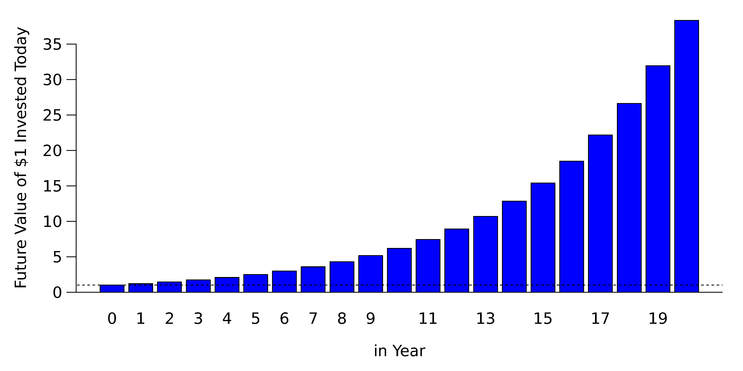
Compounding at 20% Rate of Return Per Year
compounding returns

Slide 39
Q: Preview: Different Interest Rates
If the 1-year interest rate is 20% this year, how much money will you get for a 500 investment today in one year? If the following 1-year interest will be 50%, how much money will you have after 2 years?
Notes:
$$\text{Year 1}:\$500⋅(1+20\%)=\$600$$
$$\text{Year 2}:\$600⋅(1+50\%)=\$900$$

Slide 40
Q: Holding rate of return
What is your total holding rate of return from 20% followed by 50%?
Is it $50\%+20\%=70\%$ ?
Notes:
$$\$900/\$500=80\%≠50\%+20\%$$

Slide 41
Q: Holding rate of return
What is the formula for the total holding rate of return, given the two individual rates of return?
Notes:
$$(1+r_{0,2})=(1+r_{1})⋅(1+r_{2})$$

Slide 42
The Compounding Formula
The Compounding Formula:
$$r_{0,x}=(1+r_{0,1})⋅(1+r_{1,2})...⋅(1+r_{x−1,x})$$
If the interest rate remains constant, r_{t,t+1} = r for all T, then
$$r_{0,T}=(1+r_{0,1})^{T}$$

Slide 43
NO! The Compounding Formula
The Compounding Formula:
$$1+r_{0,x}=(1+r_{0,1})⋅(1+r_{1,2})...⋅(1+r_{x−1,x})$$
If the interest rate remains constant, r_{t,t+1} = r for all T, then
$$1+r_{0,T}=(1+r_{0,1})^{T}$$
I introduce errors. You must catch them!

Slide 44
Q: Rate of return
If your bank pays you 50% per year, what is your rate of return after 2 years?
Notes:
$$(1+50\%)⋅(1+50\%)=(1+125\%)≠(1+100\%)$$
This is not the $50%+50%=100% sum!

Slide 45
Q: Earnings rate
You have $100. You invest half each in two firms. Firm 1 makes 10% this month. Firm 2 makes 20% this month. How much did your portfolio make in total?
Hint: $1.2⋅1.1=1.31$.
Notes:
This is *not* the 1+ formula! It is not two rates in time-series, but two rates at the same time.
The rate of return is 15%.

Slide 46
The Cross-Term
Can you guess what people mean by the “cross-term” in the compounding formula?
The difference between adding rates $(r_{0,1}+r_{1,2})$ and compounding returns $[(1+r_{0,1})×(1+r_{1,2})−1]$ is the term $r_{0,1}×r_{1,2}$, which is the interest on the interest.
This is also called the cross-term.
It is often small in the short run.

Slide 47
Q: Interest rate
If the 1-month interest rate is 1%, what is the 1-year rate?
Notes:
There are 12 months in 1 year. After 1 month, you have $1.01. After 2 months, you have $ $1.01 * 1.01=$1.0201 . After three months, you have $ $1.0201 * 1.01 = $1.030301 , and so on. The formula is
$$(1+0.01)^{12}≈(1+12.68\%)$$
$$(1+r_{\text{monthly}})^{12}=(1+r_{\text{yearly}})$$
So, after 1 year in the bank, for each $100 invested, you will have $112.68, not twelve times one percent ($112.00)

Slide 48
Q: Interest rate
If the 1-day rate is 0.02%, what is the 7-day (weekly) rate?
Notes:
There are 7 days in a week.
$$(1+r_{\text{weekly}})=(1+0.0002)^{7}≈1+0.001400084...$$
So, after one week, your weekly interest is $r_{\text{weekly}}≈0.1400084...\%$. Note how close $7⋅0.0002$ is to the correct answer!

Slide 49
Approximation
How good an approximation is simply adding interest?
This depends on the crossproduct. It may or may not be worth worrying about.
This will be covered again below.

Slide 50
Algebra
$$x^{a}=b⇔x=b^{1/a}$$
$$a^{x}=b⇔x=\frac{\text{log}(b)}{\text{log}(a)}$$

Slide 51
Q: Interest rate
A project for $200 promises to return 8% per year. How much will you have after one month?
Notes:
$$(1+8\%)^{1/12}≈1.0064$$
So, you will have $≈\$201.286$.

Slide 52
Q: Annual interest rate
If the annual interest rate is 14%, once compounded, what is the daily rate?
Notes:
Assume 1 year = 365 days. For each dollar put into the bank, you end up with $1.14 at the end of the year. So, solve
$$(1+r_{\text{daily}})^{365}=(1+r_{\text{yearly}})=\$1.14$$
to find that your daily interest rate is
$$r_{\text{daily}}=(1+r_{\text{year}})^{1/365}≈0.000359=0.0359\%$$

Slide 53
Q: Interest rate
The monthly interest rate is 1.5%. There are 30.4 days in the average month. What is the weekly rate? Are there different ways to calculate it?
Notes:
You have about $30.4/7≈4.35$ weeks per month.
$$1.015≈(1+r)^{4.35} ⇔ r≈0.343\%$$
Make sure students know that they can also do daily first, and then compound up.

Slide 54
Q: Rate of return
If you are doubling your money every 12 years, what is your rate of return per year?
Notes:
$$(1+x\%)^{12}=(1+100\%) ⇔ x≈5.9\%$$

Slide 55
Q: Rate of return
If a project promises to return 8% per year, how long will it take for you to double your money?
Notes:
$$(1+8\%)^{x}=(1+100\%) ⇔ x≈\text{9 years}$$

Slide 56
Q: Compounding
Is compounding more like “adding” rates or “averaging” rates?
Notes:
Adding.

Slide 57
Rule of Thumb
If both the interest rate and the number of time periods is small,
$$(1+r_{n})^{t}≈1+t⋅r_{n}$$
Adding up instead of compounding gets to be a worse approximation if time increases and if the interest rate increases. (It also matters how much money is at stake.)

Slide 58
Warning: Conventions and Jargon
Interest rates (and quotes) are tedious and often confusing because everyone computes and quotes them slightly differently
Sometimes, interest rates are intentionally obscure in order to deceive you
Always know what you are talking about and ask if you are unclear

Slide 59
Q: Interest Quote
A bank quotes you 8% interest per year. If you invest $1 million in the bank, what will you end up with?
Notes:
Unfortunately, not $1.08 million. This is important to understand.
8% is an interest quote, not an interest rate
It is merely a common way to post a number that everyone is supposed to be able to translate into an actual interest rate
For bank rates in normal demand deposit accounts, compounding is daily
Thus, the bank actually pays 8%/365 per day. Over the year, this compounds into $(1+8\%/365)^{365}≈8.33\%$.
For many common loans (e.g., mortgages), compounding is monthly, not daily. Thus, you end up paying more than the bank would seem to have asked you to pay.

Slide 60
Interest Quotes (Not Rates)
Unfortunately, many institutions give you interest “quotes,” rather than interest rates, and the two are easy to confuse.
This is especially bad with annualized interest quotes. There are many “pseudo interest rates” which are really “interest quotes” and not true “interest rates.”

Slide 61
Bank Interest Quotes (Not Rates)
Banks and lenders sometimes calculate and pay daily interest rates, although they only credit the interest payment to accounts once per month
Such banks’ daily interest rate calculation is the quoted annual interest rate divided by 365 (r_{d} = r_{y}/365) (Note: some banks use 360 days)
Some banks quote for clarity
Interest rate: 8% compounded daily
Effective annual yield: 8.33%

Slide 62
Q: Bank Interest Rate
Is the 8% posted by the bank a true annual interest rate?
Notes:
NO! If 8% was an annual interest rate, then placing $100 in the bank for 1 year should produce $\$100⋅(1.08)=\$108$. Instead, you earn $\$100⋅{\left[1+\frac{0.08}{365}\right]}^{365}≈\$108.33$.

Slide 63
Q: Bank Interest Rate
Is the ”effective annual yield” a true annual interest rate?
Notes:
Yes.
PS: Banks often name plain interest quote for loans (e.g., mortgages), and EAR for CDs and savings. Caveat Emptor: Know what you are getting!

Slide 64
Quotes vs. Rates: Treasuries
At US Treasury auctions, the government sells Treasury bills that pay $10,000 in 180 days. If the government discount quote is 10% (which is absolutely not an interest rate), then it means you can purchase the Treasury bill at the auction for $9,500.

Slide 65
This is because Treasuries use the formula
$$\text{TB Price}=\$100⋅[100−(\text{days to maturity}/360)⋅\text{discount quote}]$$
$$=\$100⋅[100−(180/360)⋅10]=\$9,500$$

Slide 66
Do not memorize this formula
Note: Financial newspapers and websites often print “95” instead of “9,500,” because it is shorter, and T-bills are quoted in units of 100.

Slide 67
Q: Treasury Quote
Assume the Treasury quote is indeed 95. If you invest $1, how much will you receive in 6 months? 95%?
Notes:
Look at the price and payoff only.
$$\$1⋅(10,000/9,500)≈\$1.0526$$

Slide 68
Present Value
Arguably, present value is the most important concept in (corporate) finance.

Slide 69
Q: Present Value
If you will receive $7 next year, and the prevailing interest rate (= [opportunity] cost of capital) for investing in this type of project is 40%, what do you value this “$7 next year” as of today?
Notes:
$$\frac{\$7}{(1+40\%)}=\$5$$

Slide 70
Q: What was your formula?
And how does it relate to the basic rate of return formula?
Notes:
It is the same rate-of-return formula again, just rearranged:
$$PV=PV_{0}=\frac{CF}{(1+r_{0,1})}$$
PV could have a time subscript of 0. This is usually omitted, because it is part of the name.

Slide 71
Q: Application
If you will receive $7 in two years, and the prevailing (alternative) interest rate [or cost of capital] is 40%/year, what do you value this $7 as of today?
Notes:
$$PV=\frac{CF_{2}}{(1+r_{0,2})}=\frac{\$7}{(1+40\%)^{2}}≈\$3.57$$

Slide 72
What is the General PV formula?
The present value of cash $CF_{t}$ at time $t$ is
$$PV=CF_{0}=\frac{CF_{t}}{(1+r_{0,t})} .$$
Discount factor: $1/(1+r_{0,t})$
this is multiplied to a future cash flow in order to obtain the future cash flow’s current value
DIscount rate: $r_{0,t}$
this is the interest rate that is used to obtain the discout factor

Slide 73
(What is the General PV formula?)
Discount rate is often called the (opportunity) cost of capital
You should think of it either representing your alternative investment opportunities (if you have money) or your cost of borrowing (if you need money)
In our perfect market, the two are the same. That is, in our financial markets, you can invest into infinitely many alternatives for a rate of return that is exactly to your cost of borrowing.
NPV simply means include the time-0 cash flow, often a cost (negative).

Slide 74
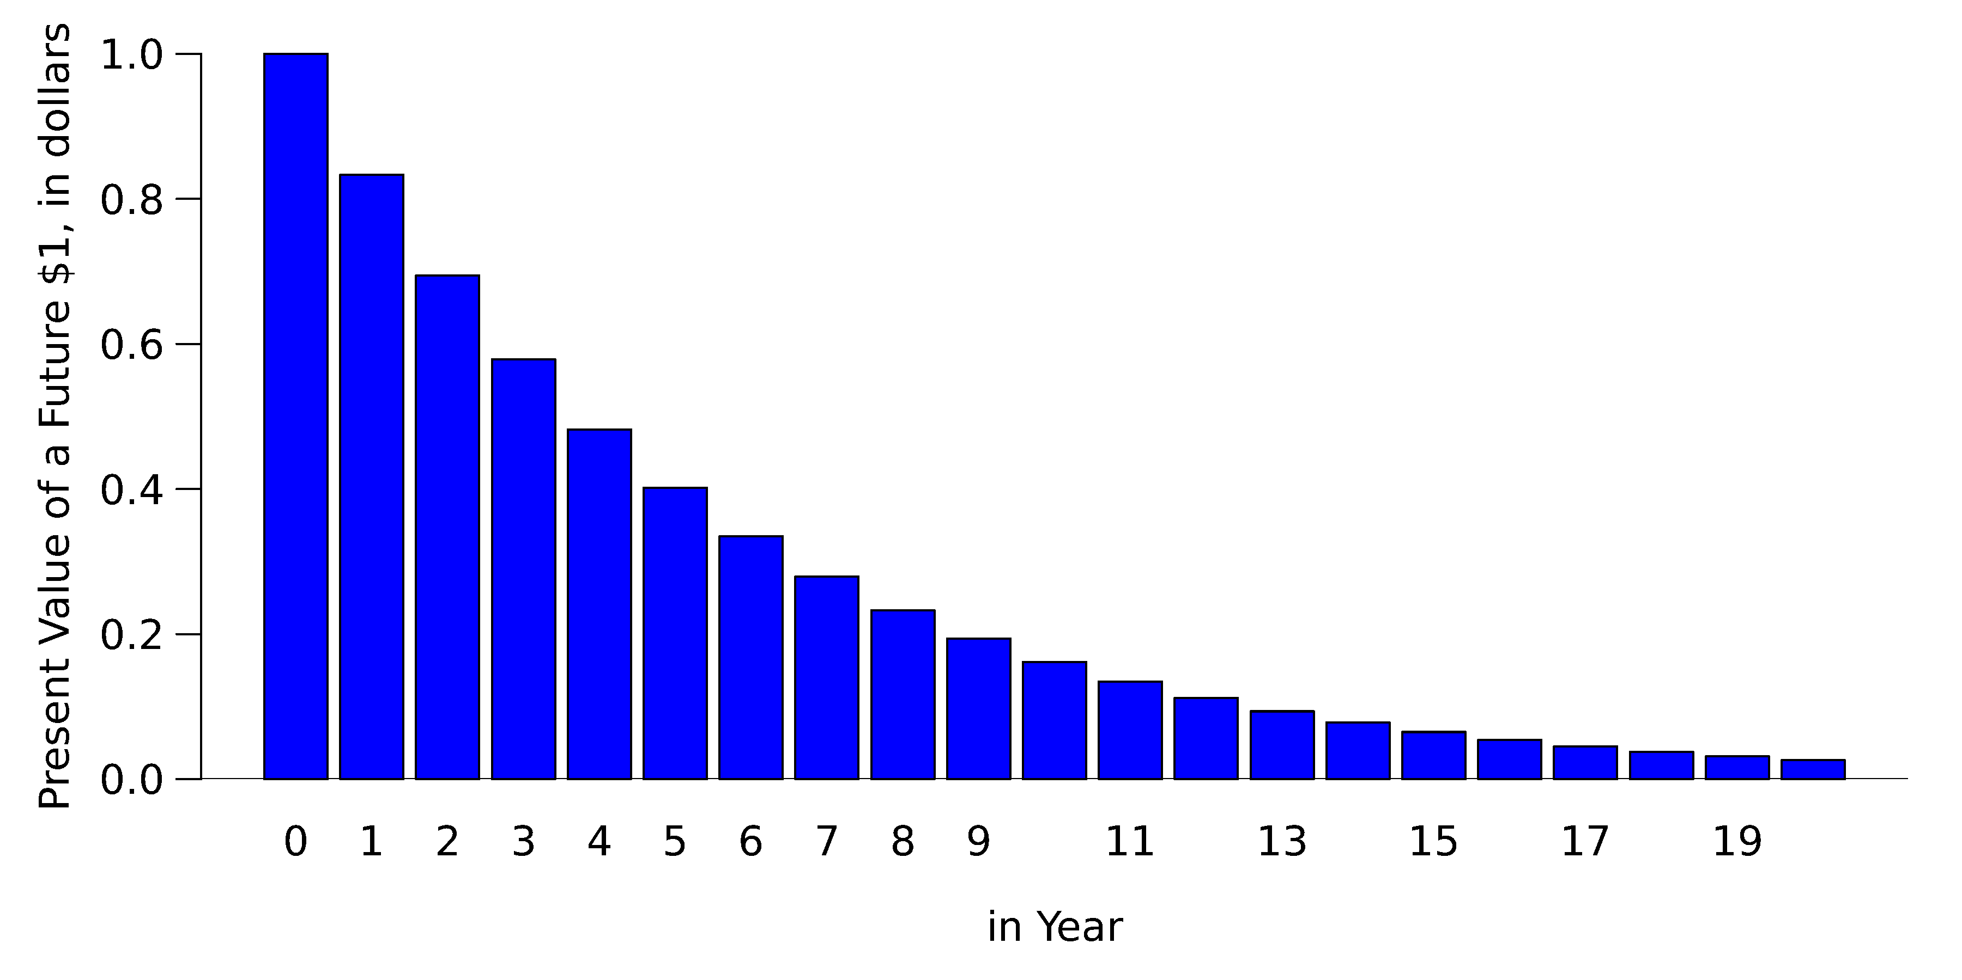
Discounting at 20% Per Year
Discounting $1

Slide 75
Q: Interest Rates & Bond Prices
How does the price of a bond change if the economy-wide interest rate changes (up)?
Notes:
This means the discount factor in the denominator changes.
The bond is defined by its promised payments, which remain the same.
The price of the bond is defined by this discount factor and the promised payment
Ask students to make up numbers. The plan is to get them to start thinking in terms of concrete examples for general concepts.

Slide 76
Q: Prevailing Interest Rate
If you will receive $7 next year and another $7 in two years, and the prevailing (alternative) interest rate [or cost of capital] is 40%, do you have the equivalent of $14?
Notes:
NO!

Slide 77
Q: Prevailing interest rate
If you will receive $7 next year and another $7 in two years, and the prevailing (alternative) interest rate [or cost of capital] is 40% per year, what would you value this project as of today? What formula are you using?
Notes:
$$PV=\frac{\$7}{(1+40\%)}+\frac{\$7}{(1+40\%)^{2}}≈\$8.57$$
Note additivity. PV converts apples and oranges into the same units.

Slide 78
Q: Capital Budgeting
If this project costs $8, should you take this project?
Notes:
The Net Present Value is $8.57. So, the answer is yes!
Note the net in NPV means that the upfront cost is included.

Slide 79
Q: Capital Budgeting
If the cost of capital were 80%/year, should you take this project?
Notes:
The Net Present Value is $8.57. So, the answer is yes!

Slide 80
NPV Capital Budgeting
The net present value is
$$NPV=CF_{0}+\frac{CF_{1}}{(1+r_{0,1})}+\frac{CF_{2}}{(1+r_{0,2})}+...$$
$$=\sum_{t=0}^{∞}{\frac{CF_{t}}{(1+r_{0,t})}} .$$
“Net” because the CF₀ is often negative.
In a perfect world, take all positive NPV projects.
This is called the NPV capital budgeting rule.

Slide 81
The Logical Foundation
Here is how a perfect world w/o uncertainty must work:
The NPV rule is correct and optimal
Other rules may leave money on the table
and positive NPV projects must be scarce.
Otherwise, money would compete to bid up $r$

Slide 82
(The Logical Foundation)
The proof is trivial. For example, presume that, in our perfect market, you can borrow or lend money at 8% anywhere today. The NPV formula says you will not make money on projects that cost $1 today and yield $1.08 next year. It says you should take all projects that yield more than $1.08 next year. Now, presume that you have (infinitely) many investment opportunities that cost $0.99 and yield $1.08. (The NPV is positive.)
How would you get rich? Borrow $0.99 and use it to buy the project. Tomorrow, you pay $1.07, and receive $1.08. You earn $0.01. If you prefer money today, borrow against the $0.01, or borrow $1.00 to begin with.

Slide 83
(The Logical Foundation)
If such projects are in limited supply, you (and everyone else) would buy up all such projects, until the project’s equilibrium price has increased to make the project zero NPV.
(If you can short projects, and you have willing buyers for negative NPV projects, you can just sell them and thereby invert the argument.)

Slide 84
Q: Good/bad investment
Is a good stock or good firm a good investment? Is a bad stock or bad firm a bad investment?
Good firm could mean growing. Bad firm could mean shrinking.
Notes:
It depends on the price
if price is too high, a good firm may be a bad investment
if price is too low, a bad firm may be a great investment

Slide 85
Fast vs. Slow Growing Firms
In a perfect market, neither is a better investment because both firms should be priced fairly
In the real world, the question is whether the price is appropriate or not
if price of either is too high, they are both bad invesments
if price of either is too low, they are both good investments
Stupid investors may think growing firms are better and drive the price too high by piling in

